Slide 1
Dashboard Ver 0 1 (draft) 10/3/2018

Slide 2
Contents
1
Total Population @ District (ADM1) and TA (ADM2) Level
2
Area Covered by Health Posts within 5 Km @ ADM1
3
Population Coverage by Health Posts and Cell Towers
4
Area Covered by Cell Towers within 10 Km @ ADM1
5
User Density and Voronoai Polygon

Slide 3
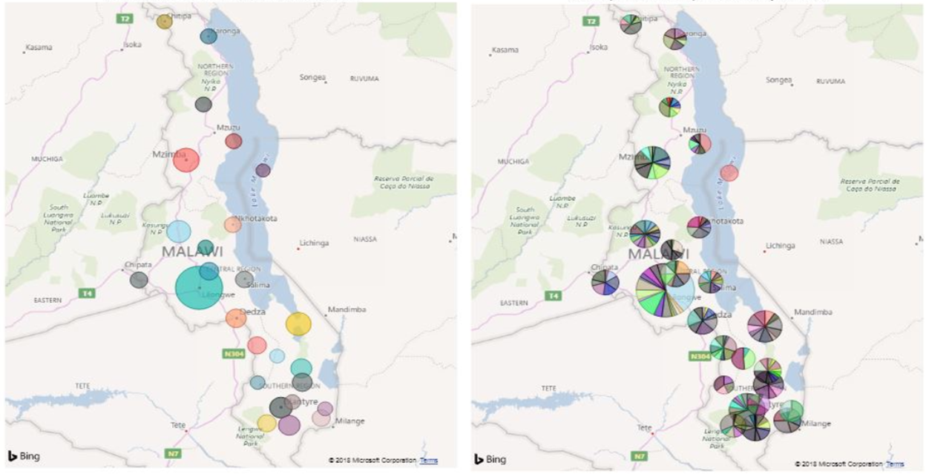
Total Population @ District (ADM1) / TA (ADM2) level
Total population @ District (ADM1) level
Total population @ TA (ADM2) level
Size of circle signifies population count and color signifies various districts (ADM1) in Malawi
Size of circle signifies population count and color signifies various TA (ADM2) in Malawi

Slide 4
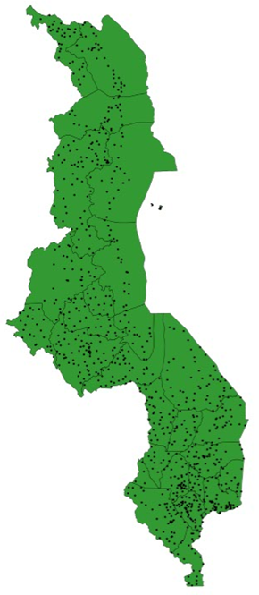
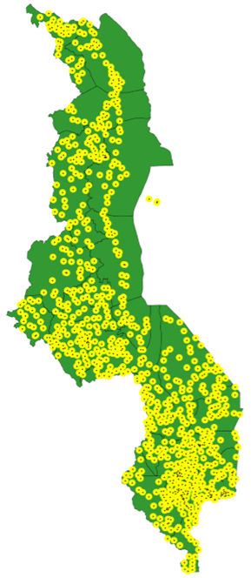
Area covered by Health Posts within 5 Km
Yellow color signifies the area covered by a health posts within 5 km radius
Black spots signifies the location of health post
Green color signifies the area not covered by health posts within 5 km radius
**Only Dispensary, Health Centre, Health Post and Hospital facilities are in our scope of health services

Slide 5
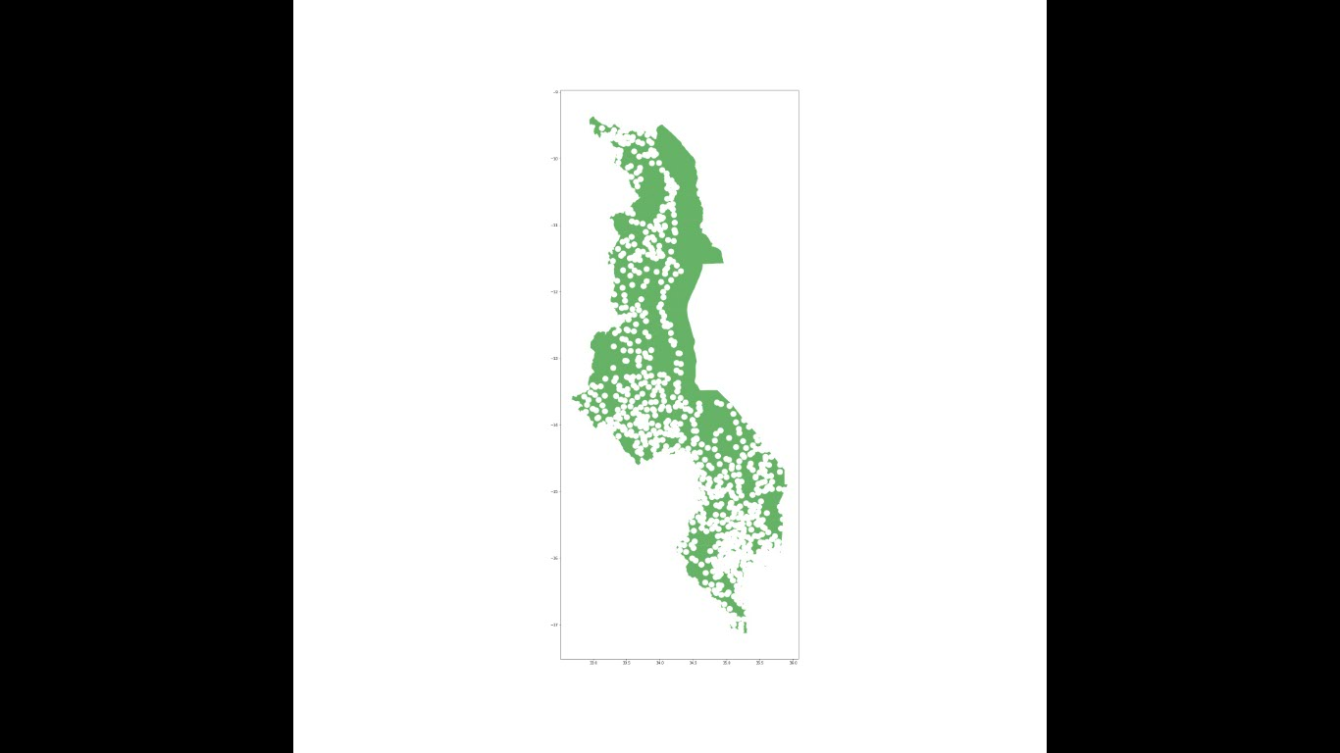
Area not covered by Health Posts within 5 Km
Green color signifies the area not covered by health post within 5 km

Slide 6
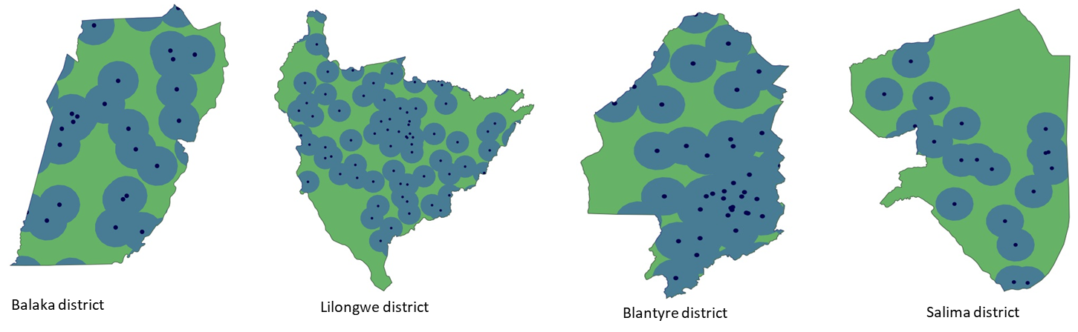
Area covered by Health post within 5 Km @ ADM1
Black spot signifies location of health posts
Blue color signifies the area covered by health post within 5 Km of radius
Green color signifies the area not covered by the health post within 5 Km of radius

Slide 7
Malawi population coverage as per Health Posts and Cell Towers
Malawi population coverage
Description | Population coverage (%)
Population coverage within 5 km radius of the Health posts | 74.12
Population coverage within 10 km radius of the cell towers | 84.65
**Only Dispensary, Health Centre, Health Post and Hospital facilities are in our scope of health services

Slide 8
Cell Tower details

Slide 9
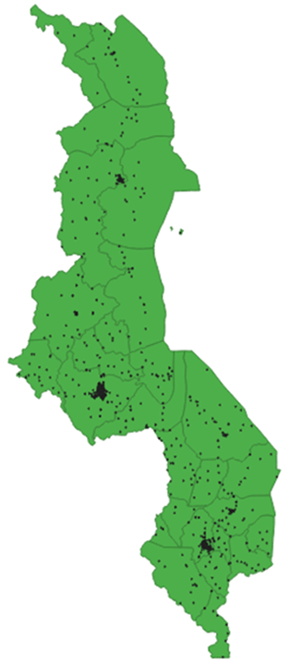
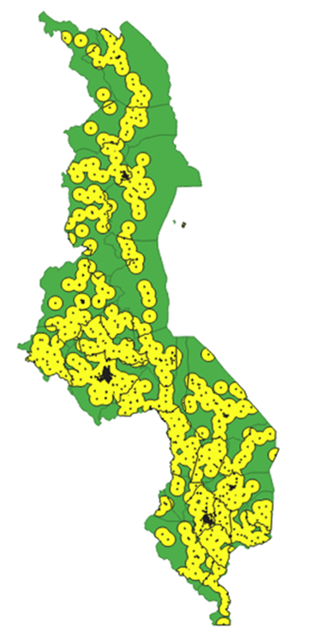
Area covered by Cell Towers within 10 Km
Yellow color signifies area covered within 10 km radius of cell towers
Black spots signifies the presence of cell towers
Green color signifies the area not covered by cell towers within within 10 km

Slide 10
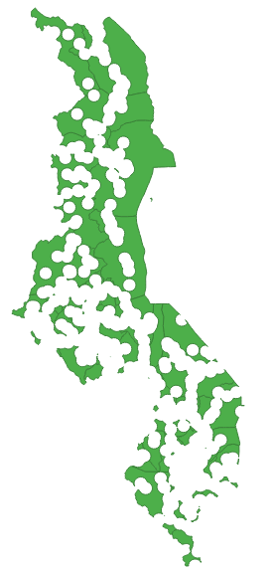
Area not covered by Cell Towers within 10 Km
Green color signifies the area not covered by cell towers within within 10 km

Slide 11
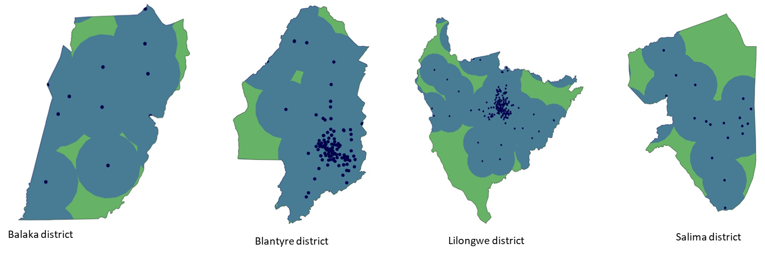
Area covered by Cell Tower within 10 Km @ ADM1
Black spot signifies location of cell towers
Blue color signifies the area covered by cell towers within 10 Km of radius
Green color signifies the area not covered by the cell tower within 10 Km of radius

Slide 12
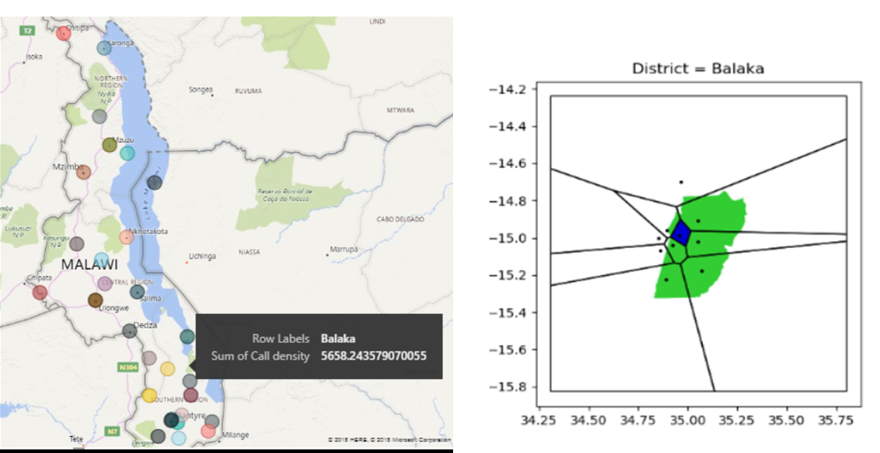
User Density and Voronoi Tessellation at District level
Use density as per District
Voronoi Tessellation of District
Area in “Blue” color of Voronoi polygon completely falling in district whereas area in “Green” color” partially falling in that district. Black dot signifies the location of cell tower.
Size of circle signifies user density and color signifies various districts (ADM1) in Malawi
** Randomly generated value of user density is used in this map

Slide 13
Appendix

